Slide 1
SIMATS ENGINEERING
ASSESSMENT TOOL 1: Analytical Problem Solving
COURSE NAME: COMPUTER VISION COURSE CODE:ITA05 COURSE OUTCOME COVERED
CO2: Apply image enhancement and segmentation techniques for extracting meaningful regions from
images. (BTL 3)
Assessment Tool Weightage: 50%
QUESTIONS: 5
Total Marks50 Annexure A
Analytical Problem Solving
Duration :60 Minutes
Code of Conduct:
I K.Amrutha/192425366(Name / Reg No) certify that this submission is my original work and that I have adhered to the guidelines specified for this assessment.I understand that any violation of academic integrity rules will result in disciplinary action.
Signature of the student:K.Amrutha
RUBRICS FOR CALCULATION:
Criteria | Weightage | Level 4 (Exemplary) | Level 3 (Proficient) | Level 2 (Developing) | Level 1 (Beginning) | Marks (100)
Problem Understanding | 20% | Clearly interprets problem, identifies all parameters and requirements accurately | Understands problem with minor gaps | Partial understanding; misses key elements | Misinterprets or unable to understand problem
Method Selection | 20% | Selects most appropriate method/formula with strong justification | Selects correct method with minor errors | Inappropriate or partially correct method | Unable to select method
Solution Process | 25% | Logical, systematic steps with correct approach throughout | Mostly correct steps with minor mistakes | Disorganized steps; multiple errors | No clear process
Accuracy of Calculation | 20% | All calculations accurate; correct final answer | Minor calculation errors | Frequent errors; incorrect final answer | No valid calculations
Interpretation of Results | 15% | Clearly interprets results with units and engineering relevance | Basic interpretation with minor omissions | Limited or unclear interpretation | No interpretation

Slide 2
Grey Level Transformation
Explain the purpose of grey level transformation in image enhancement.
Apply a negative transformation s=255-r to the pixel values: r=[50,100,150,200]
Compute the transformed values.
Log Transformation
Explain how log transformation enhances low-intensity pixels.
Given s=clog(1+r), where c=10, compute s for: r=[0,10,50,100]
Histogram Processing
Explain the role of histogram equalization in contrast enhancement.
Given a 3-bit image with histogram:
Intensit y | Frequenc y
0 | 2
1 | 2
2 | 4
3 | 8
Compute the cumulative distribution and equalized intensity values.
Spatial Filtering (Smoothing)
Explain the purpose of spatial filtering for smoothing.
Apply a 3×3 averaging filter to the following region: 10 20 30 20 30 40 30 40 50
Compute the new center pixel value.
Spatial Filtering (Sharpening)
Explain how sharpening enhances image details.
Apply the Laplacian mask:
[0 -1 0}, {-1 4 -1], { 0 -1 0 ]
to the matrix:
10 10 10, 10 20 10, 10 10 10
Compute the output at the center.

Slide 3

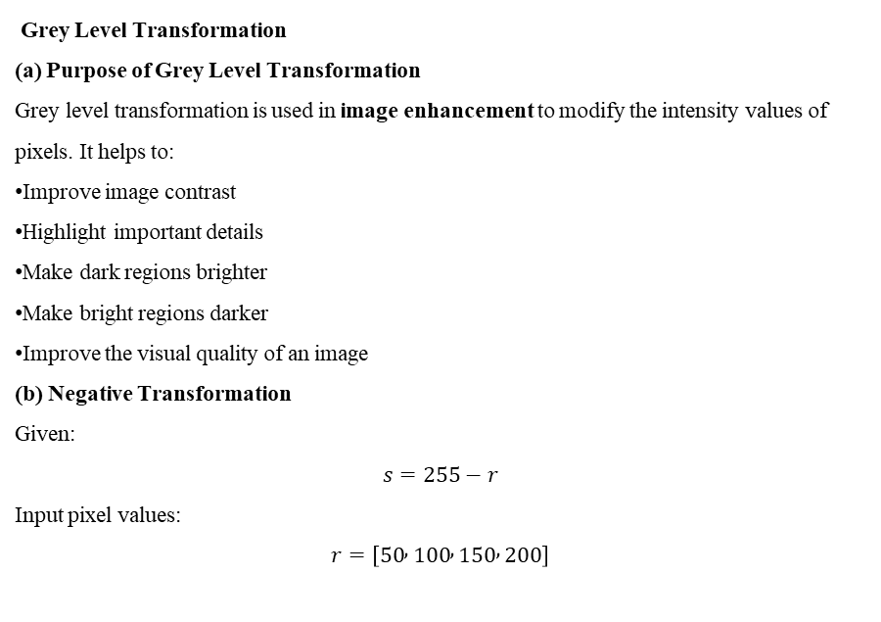
Grey Level Transformation
Explain the purpose of grey level transformation in image enhancement.
Apply a negative transformation s=255-r to the pixel values: r=[50,100,150,200]
Compute the transformed values.
Grey Level Transformation
(a) Purpose of Grey Level Transformation
Grey level transformation is used in image enhancement to modify the intensity values of pixels. It helps to:
Improve image contrast
Highlight important details
Make dark regions brighter
Make bright regions darker
Improve the visual quality of an image
(b) Negative Transformation
Given:
$$s=255−r$$
Input pixel values:
$$r=\left[50 , 100 , 150 , 200\right]$$
Input (r) | Calculation | Output (s)
50 | (255-50) | 205
100 | (255-100) | 155
150 | (255-150) | 105
200 | (255-200) | 55
Final Answer:
$$\boxed{s=\left[205 , 155 , 105 , 55\right]}$$

Slide 4
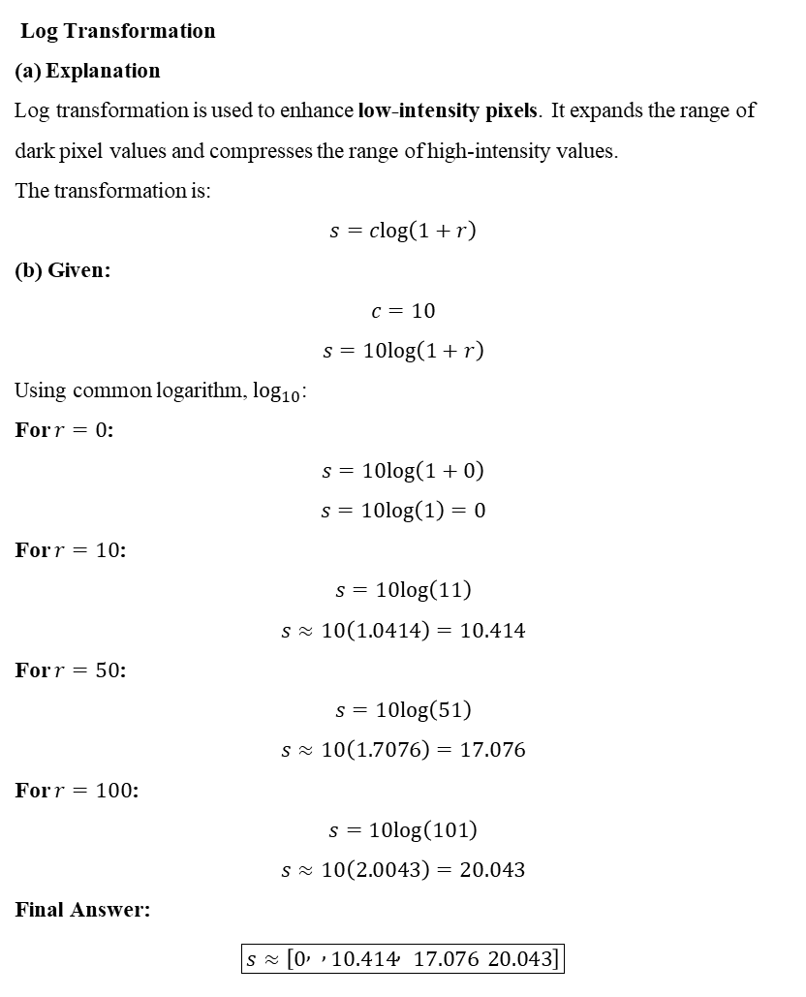
Log Transformation
Explain how log transformation enhances low-intensity pixels.
Given s=clog(1+r), where c=10, compute s for: r=[0,10,50,100]
Log Transformation
(a) Explanation
Log transformation is used to enhance low-intensity pixels. It expands the range of dark pixel values and compresses the range of high-intensity values.
The transformation is:
$$s=clog⁡\left(1+r\right)$$
(b) Given:
$$c=10$$
$$s=10log⁡\left(1+r\right)$$
Using common logarithm, $\log_{10}$:
For $r=0$:
$$s=10log⁡\left(1+0\right)$$
$$s=10log⁡\left(1\right)=0$$
For $r=10$:
$$s=10log⁡\left(11\right)$$
$$s≈10\left(1.0414\right)=10.414$$
For $r=50$:
$$s=10log⁡\left(51\right)$$
$$s≈10\left(1.7076\right)=17.076$$
For $r=100$:
$$s=10log⁡\left(101\right)$$
$$s≈10\left(2.0043\right)=20.043$$
Final Answer:
$$\boxed{s≈\left[0 , , 10.414 , 17.076 20.043\right]}$$

Slide 5
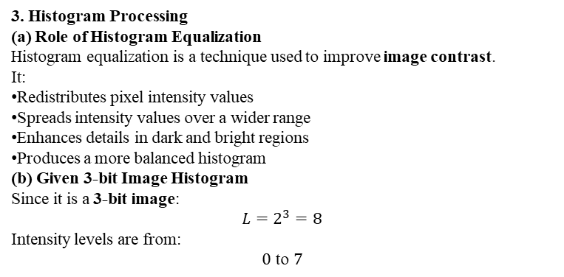
Histogram Processing
Explain the role of histogram equalization in contrast enhancement.
Given a 3-bit image with histogram:
Intensit y | Frequenc y
0 | 2
1 | 2
2 | 4
3 | 8
3. Histogram Processing
(a) Role of Histogram Equalization
Histogram equalization is a technique used to improve image contrast.
It:
Redistributes pixel intensity values
Spreads intensity values over a wider range
Enhances details in dark and bright regions
Produces a more balanced histogram
(b) Given 3-bit Image Histogram
Since it is a 3-bit image:
$$L=2^{3}=8$$
Intensity levels are from:
$$0 \text{to} 7$$
Intensity (r_k) | Frequency (n_k)
0 | 2
1 | 2
2 | 4
3 | 8

Slide 6
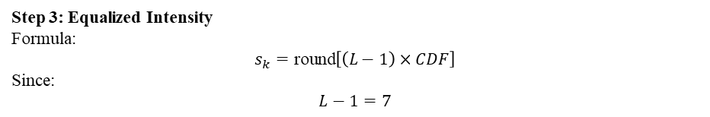

Step 1: Calculate Probability
$$p\left(r_{k}\right)=\frac{n_{k}}{N}$$
Intensity | Frequency | Probability
0 | 2 | (2/16=0.125)
1 | 2 | (2/16=0.125)
2 | 4 | (4/16=0.25)
3 | 8 | (8/16=0.5)
Step 2: Calculate Cumulative Distribution
Intensity | Probability | CDF
0 | 0.125 | 0.125
1 | 0.125 | 0.250
2 | 0.250 | 0.500
3 | 0.500 | 1.000
Step 3: Equalized Intensity
Formula:
$$s_{k}=\text{round}\left[\left(L−1\right)×CDF\right]$$
Since:
$$L−1=7$$

Slide 7

Original Intensity | CDF | Calculation | Equalized Value
0 | 0.125 | (7(0.125)=0.875) | 1
1 | 0.250 | (7(0.25)=1.75) | 2
2 | 0.500 | (7(0.5)=3.5) | 4
3 | 1.000 | (7(1)=7) | 7
Final Mapping:
$$\boxed{0→1, 1→2, 2→4, 3→7}$$
4. Spatial Filtering — Smoothing
(a) Purpose of Spatial Filtering
Smoothing filters are used to:
Reduce noise
Remove small variations
Blur an image
Smooth edges
Improve image quality before further processing
(b) 3×3 Averaging Filter
Given region:
$$\left[\begin{matrix}10 & 20 & 30 \\ 20 & 30 & 40 \\ 30 & 40 & 50\end{matrix}\right]$$
The average filter calculates:
$$\text{New} \text{Center} \text{Pixel}=\frac{\text{Sum} \text{of} \text{all} \text{pixels}}{9}$$
Sum:
$$10+20+30+20+30+40+30+40+50=270$$
Therefore:
Spatial Filtering (Smoothing)
Explain the purpose of spatial filtering for smoothing.
Apply a 3×3 averaging filter to the following region: 10 20 30 20 30 40 30 40 50
Compute the new center pixel value.

Slide 8
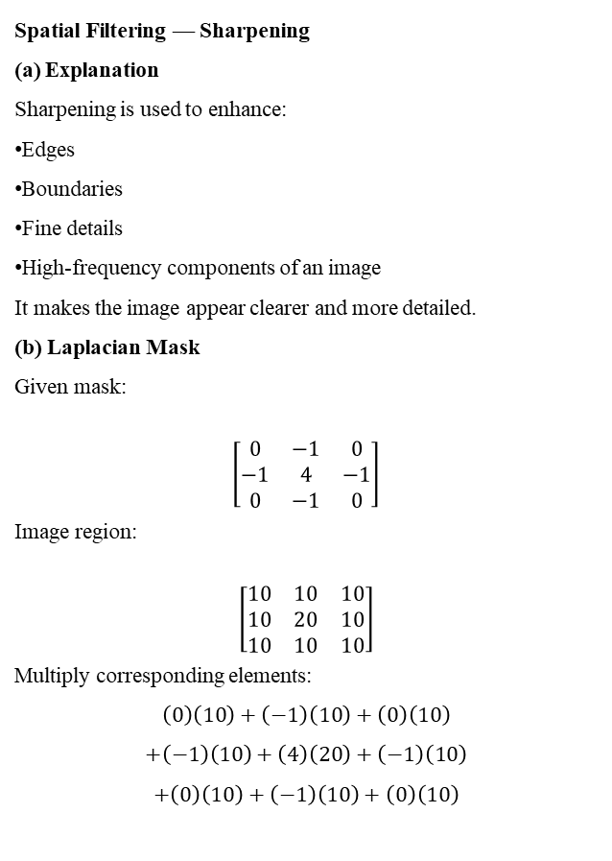

$$\text{New} \text{Center} \text{Pixel}=\frac{270}{9}$$
$$\boxed{30}$$
Final Answer:
$$\boxed{\text{New} \text{center} \text{pixel}=30}$$
Spatial Filtering (Sharpening)
Explain how sharpening enhances image details.
Apply the Laplacian mask:
[0 -1 0}, {-1 4 -1], { 0 -1 0 ]
to the matrix:
10 10 10, 10 20 10, 10 10 10
Compute the output at the center.
Spatial Filtering — Sharpening
(a) Explanation
Sharpening is used to enhance:
Edges
Boundaries
Fine details
High-frequency components of an image
It makes the image appear clearer and more detailed.
(b) Laplacian Mask
Given mask:
$$\left[\begin{matrix}0 & −1 & 0 \\ −1 & 4 & −1 \\ 0 & −1 & 0\end{matrix}\right]$$
Image region:
$$\left[\begin{matrix}10 & 10 & 10 \\ 10 & 20 & 10 \\ 10 & 10 & 10\end{matrix}\right]$$
Multiply corresponding elements:
$$\left(0\right)\left(10\right)+\left(−1\right)\left(10\right)+\left(0\right)\left(10\right)$$
$$+\left(−1\right)\left(10\right)+\left(4\right)\left(20\right)+\left(−1\right)\left(10\right)$$
$$+\left(0\right)\left(10\right)+\left(−1\right)\left(10\right)+\left(0\right)\left(10\right)$$

Slide 9
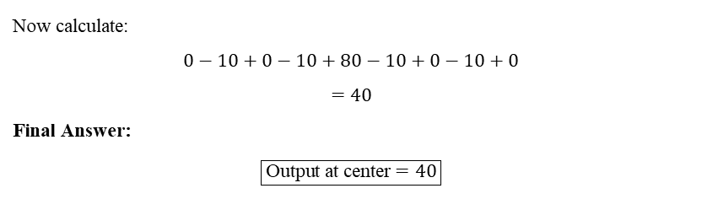
Now calculate:
$$0−10+0−10+80−10+0−10+0$$
$$=40$$
Final Answer:
$$\boxed{\text{Output} \text{at} \text{center}=40}$$

